Slide 1
Identity Authentication
With extra material for further reading, indicated by symbol *

Slide 2
Authentication
Basics
Passwords
Challenge-Response
Biometrics
Location
Multiple Methods
2
Info-Sec 2023
Notes:
2

Slide 3
Basics
Authentication: binding of identity to subject
  Identity is that of external entity (my identity, Van, etc.)
  Subject is computer entity (process, etc.)
Note:
  message authentication is a different topic and already mentioned in the applications of hash functions
3
Info-Sec 2023

Slide 4
Establishing Identity
One or more of the following
  What entity knows (eg. password)
  What entity has (eg. Identity card, smart card)
  What entity is (eg. fingerprints, retinal characteristics)
  Where entity is (eg. In front of a particular terminal)
4

Slide 5
Authentication System
We need a formal definition, rather abstract view, of an AS
A 5-tuple (A, C, F, L, S)
  A – a set: information that proves identity
  C – a set: information stored on computer and used to validate authentication information
  F: a set of complementation functions; f : A → C
    To compute complement information from identity information
  L: authentication functions that prove identity
  S: functions enabling entity to create, alter information in A or C
5
Info-Sec 2023

Slide 6
Example
Password system, with passwords stored on line in clear text
  A set of strings making up passwords
  C = A
  F singleton set of identity function { I }
  L single equality test function { eq }
  S function to set/change password
6
Info-Sec 2023

Slide 7
Passwords
Sequence of characters
  Examples: 10 digits, a string of letters, etc.
  Generated randomly, by user, by computer with user input
Sequence of words
  Examples: pass-phrases
Algorithms
  Examples: challenge-response, one-time passwords
7
Info-Sec 2023

Slide 8
Storage
Store as cleartext
  If password file compromised, all passwords revealed
Encipher file
  Need to have decipherment, encipherment keys in memory
  Reduces to previous problem 🡺 need something else
Solution: Instead store one-way hash of password
  Got the file, attacker must still guess passwords or invert the hash values
8
Info-Sec 2023
Notes:
8

Slide 9
Example: Unix
By definition, a 5-tuple (A, C, F, L, S)
  A – a set: information that proves identity
    A = { strings of 8 chars or less }
  C – a set: information stored on computer and used to validate authentication information
    C = {hash values of password}
  F: a set of complementation functions; f : A → C
    F = { versions of modified DES }
  L: authentication functions that prove identity
    L = { login, su, … }
  S: functions enabling entity to create, alter information in A or C
    S = { passwd, nispasswd, passwd+, … }
9
Info-Sec 2023

Slide 10
Example: Unix
By definition, a 5-tuple (A, C, F, L, S)
  A – a set: information that proves identity
    A = { strings of 8 chars or less }
  C – a set: information stored on computer and used to validate authentication information
    C = {hash values of password}
  F: a set of complementation functions; f : A → C
    F = { versions of modified DES }
  L: authentication functions that prove identity
    L = { login, su, … }
  S: functions enabling entity to create, alter information in A or C
    S = { passwd, nispasswd, passwd+, … }
10
Info-Sec 2023

Slide 11
Attacking passwords
Goal: find a ∈ A such that:
  For some f ∈ F, f(a) = c ∈ C
  c is associated with entity
Two ways to determine whether a meets these requirements:
  By trying computing f(a) for a set of a values until succeed
  By trying calling I(a) until succeed (I(a) returns true)
11
Info-Sec 2023

Slide 12
Preventing Attacks
How to prevent this:
  Hide at least one of a, f, or c
    Prevents obvious attack from above
    Example: UNIX/Linux shadow password files
      Hides the c’s
  Block access to all l ∈ L or result of l(a)
    Prevents attacker from knowing if guess succeeded
    Example: preventing any logins to an account from a network
      Prevents knowing results of l (or accessing l)
12
Info-Sec 2023

Slide 13
Dictionary Attacks
Trial-and-error from a list of potential passwords
  Off-line: know f and c’s, and repeatedly try different guesses g ∈ A until the list is done or passwords guessed
    Examples: crack, john-the-ripper
  On-line: have access to functions in L and try guesses g until some l(g) succeeds
    Examples: trying to log in by guessing a password
13
Info-Sec 2023

Slide 14
Success probability over a time period
Anderson’s formula:
P probability of guessing a password in specified period of time
G number of guesses tested in 1 time unit
T number of time units
N number of possible passwords (|A|)
Then P ≥ TG/N
14
Info-Sec 2023

Slide 15
Example
Goal
  Passwords drawn from a 96-char alphabet
  Can test 10⁴ guesses per second
  Probability of a success to be 0.5 over a 365 day period
  What is minimum password length?
Solution
  N ≥ TG/P = (365×24×60×60)×10⁴/0.5 = 6.31×10¹¹
  Choose s such that Σ^{s}_{j=0} 96^{j} ≥ N
  So s ≥ 6, meaning passwords must be at least 6 chars long
15
Info-Sec 2023

Slide 16
Exercise
X = number defined by last 2 digits of your student ID; Y = X mod 4
Assume that H is a cryptographic hash function with output size (Y+2)*16 bits. Assume that Scorpion-i (i=1-9) is a specifically designed line of hardware chips for computing H, where Scorpion-i can create 10^{i} * 1000 hash values a second (e.g. Scorpion-2 can do 100,000 hashes/sec). This product line is the best, fastest and affordable, in the market, priced at i^{i/2} *$1000 (e.g $2000 for i=2, $16000 for i=4).
An authentication system requires its users to pick their passwords of length exactly 6 from an alphabet of size N=(X mod 50)+ 40. Using H, this system maintains the hash values of the passwords of all the users. An enemy, who has gained access to this hashed password file, aims to launch an off-line attack to break the password of an important user. Using the Scorpion chips, how much the enemy has to spend in order to finish within a month with success probability (6+Y)*10%?
16

Slide 17
On password selection
Random selection
  Any password from A equally likely to be selected
Pronounceable passwords
User selection of passwords
17
Info-Sec 2023

Slide 18
Pronounceable Passwords
Generate phonemes randomly
  Phoneme is unit of sound, eg. cv, vc, cvc, vcv
  Examples: helgoret, juttelon are; przbqxdfl, zxrptglfn are not
Problem: too few
Solution: key crunching
  Run long key through hash function and convert to printable sequence
  Use this sequence as password
18
Info-Sec 2023

Slide 19
User Selection
Problem: people pick easy to guess passwords
  Based on account names, user names, computer names, place names
  Dictionary words (also reversed, odd capitalizations, control characters, “elite-speak”, conjugations or declensions, swear words, Torah/Bible/Koran/… words)
  Too short, digits only, letters only
  License plates, acronyms, social security numbers
  Personal characteristics or foibles (pet names, nicknames, job characteristics, etc.
19
Info-Sec 2023

Slide 20
Picking Good Passwords
“LlMm*2^Ap”
  Names of members of 2 families
“OoHeO/FSK”
  Second letter of each word of length 4 or more in third line of third verse of Star-Spangled Banner, followed by “/”, followed by author’s initials
What’s good here may be bad there
  “DMC/MHmh” bad at Dartmouth (“Dartmouth Medical Center/Mary Hitchcock memorial hospital”), ok here
Why are these now bad passwords? ☹
20
Info-Sec 2023

Slide 21
Proactive Password Checking
Analyze proposed password for “goodness”
  Always invoked
  Can detect, reject bad passwords for an appropriate definition of “bad”
  Discriminate on per-user, per-site basis
  Needs to do pattern matching on words
  Needs to execute subprograms and use results
    Spell checker, for example
  Easy to set up and integrate into password selection system
21
Info-Sec 2023

Slide 22
Salting
Goal: slow dictionary attacks
Method: perturb hash function so that:
  Parameter controls which hash function is used
  Parameter differs for each password
  So given n password hashes, and therefore n salts, need to hash guess n
22
Info-Sec 2023

Slide 23
Examples
Vanilla UNIX method
  Use DES to encipher 0 message with password as key; iterate 25 times
  Perturb E table in DES in one of 4096 ways
    12 bit salt flips entries 1–11 with entries 25–36
Alternate methods
  Use salt as first part of input to hash function
23
Info-Sec 2023

Slide 24
Unix actually is …
UNIX system standard hash function
  Hashes password into 11 char string using one of 4096 hash functions
As authentication system:
  A = { strings of 8 chars or less }
  C = { 2 char hash id || 11 char hash }
  F = { 4096 versions of modified DES }
  L = { login, su, … }
  S = { passwd, nispasswd, passwd+, … }
24
Info-Sec 2023

Slide 25
Exercise
Assume that H is a cryptographic hash function with output size (Y+2)*16 bits. Assume that Scorpion-i (i=1-9) is a specifically designed line of hardware chips for computing H, where Scorpion-i can create 10^{i} * 1000 hash values a second, priced at i^{i/2} *$1000.
1. An authentication system requires its users to pick their passwords of length exactly 6 from an alphabet of size N=(X mod 50)+ 40. Using H, this system maintains the hash values of the passwords of all the users. An enemy, who has gained access to this hashed password file, aims to launch an off-line attack to break the password of an important user. Using the Scorpion chips, how much the enemy has to spend in order to finish within a month with success probability (6+Y)*10%?
2. The owner decides to enhance the above password system by using salt so that the enemy will need to spend at least 10 times the above mentioned amount of money to achieve the same goal. How many salt bits he/she need to use to achieve this purpose ?
25

Slide 26
Password Cracking: Do the Math*
* Further reading
Assumptions:
Pwds are 8 chars, 128 choices per character
  Then 128⁸ = 2⁵⁶ possible passwords
There is a password file with 2¹⁰ pwds
Attacker has dictionary of 2²⁰ common pwds
Probability 1/4 that password is in dictionary
Work is measured by number of hashes
Part 2 ⎯ Access Control 26

Slide 27
Salt with slow hash *
Hash password with salt
Choose random salt s and compute
y = h(password, s)
and store (s,y) in the password file
Note that the salt s is not secret
  Analogous to IV
Still easy to verify salted password
But lots more work for Hacker
  Why?
Part 2 ⎯ Access Control 27
Notes:
For salted passwords, Trudy has to re-compute her dictionary of hashes for each specific password.
27

Slide 28
Password Cracking: Case I *
Attack 1 specific password without using a dictionary
  E.g., administrator’s password
  Must try 2⁵⁶/2 = 2⁵⁵ on average
  Like exhaustive key search
Does salt help in this case?
Part 2 ⎯ Access Control 28

Slide 29
Password Cracking: Case II *
Attack 1 specific password with dictionary
With salt
  Expected work: 1/4 (2¹⁹) + 3/4 (2⁵⁵) ≈ 2^{54.6}
  In practice, try all pwds in dictionary…
  …then work is at most 2²⁰ and probability of success is 1/4
What if no salt is used?
  One-time work to compute dictionary: 2²⁰
  Expected work is of same order as above
  But with precomputed dictionary hashes, the “in practice” attack is essentially free…
Part 2 ⎯ Access Control 29

Slide 30
Password Cracking: Case III *
Any of 1024 pwds in file, without dictionary
  Assume all 2¹⁰ passwords are distinct
  Need 2⁵⁵ comparisons before expect to find pwd
If no salt is used
  Each computed hash yields 2¹⁰ comparisons
  So expected work (hashes) is 2⁵⁵/2¹⁰ = 2⁴⁵
If salt is used
  Expected work is 2⁵⁵
  Each comparison requires a hash computation
Part 2 ⎯ Access Control 30
Notes:
30
Picture would be useful here

Slide 31
Password Cracking: Case IV *
Any of 1024 pwds in file, with dictionary
  Prob. one or more pwd in dict.: 1 – (3/4)¹⁰²⁴ ≈ 1
  So, we ignore case where no pwd is in dictionary
If salt is used, expected work less than 2²²
  See book, or slide notes for details
  Work ≈ size of dictionary / P(pwd in dictionary)
What if no salt is used?
  If dictionary hashes not precomputed, work is about 2¹⁹/2¹⁰ = 2⁹
Part 2 ⎯ Access Control 31
Notes:
31
Calculation for salted case:
Number the passwords in file, pwd1, pwd2, …,pwd1024
Consider checking each pwd in turn. The probability pwd1 is in the dictionary is 1/4 and, if so, expected work (no. of hashes) is 2^19. If pwd1 is not in dictionary but pwd2 is, we do 2^20 hashes (for pwd1) plus an expected 2^19 hashes for pwd2 and so on. We find the expected work factor is
(1/4)*(2^19) + (3/4)*((1/4)*(2^20+2^19) + (3/4)*((1/4)*(2*2^20+2^19)+…+(3/4)((1/4)(1023*2^20+2^19)))…) < 2^22

Slide 32
Guessing Through L
Cannot prevent these
  Otherwise, legitimate users cannot log in
Make them slow
  Backoff
  Disconnection
  Disabling
    Be very careful with administrative accounts!
  Jailing
    Allow in, but restrict activities
32
Info-Sec 2023

Slide 33
Password Aging
Force users to change passwords after some time has expired
  How do you force users not to re-use passwords?
    Record previous passwords
    Block changes for a period of time
  Give users time to think of good passwords
    Don’t force them to change before they can log in
    Warn them of expiration days in advance
33
Info-Sec 2023

Slide 34
Challenge-Response
User, system share a secret function f (in practice, f is a
known function with unknown parameters, such as a
cryptographic key)
user
request to authenticate
system
user
random message r
(the challenge)
system
user
f(r)
(the response)
system
Info-Sec 2023
34

Slide 35
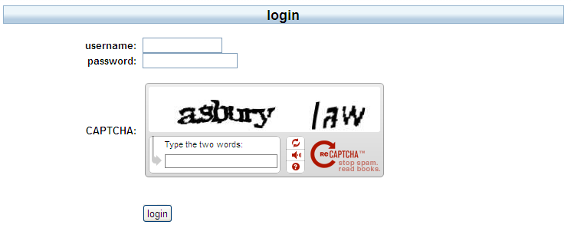
Pass Algorithms
Challenge-response with the function f itself a secret
  Challenge is a random string of characters
  Response is some function of that string
  Usually used in conjunction with fixed, reusable password
35
Info-Sec 2023

Slide 36
One-Time Passwords
Password that can be used exactly once
  After use, it is immediately invalidated
Challenge-response mechanism
  Challenge is number of authentications; response is password for that particular number
Problems
  Synchronization of user, system
  Generation of good random passwords
  Password distribution problem
36
Info-Sec 2023

Slide 37
S/Key
One-time password scheme based on idea of Lamport
h one-way hash function (MD5 or SHA-1, for example)
User chooses initial seed k
System calculates:
  h(k) = k₁, h(k₁) = k₂, …, h(k_{n–1}) = k_{n}
Passwords are reverse order:
  p₁ = k_{n}, p₂ = k_{n–1}, …, p_{n–1} = k₂, p_{n} = k₁
37
Info-Sec 2023

Slide 38
S/Key Protocol
System stores maximum number of authentications n, number
of next authentication i, last correctly supplied password p_{i–1}.
user
{ name }
system
{ i }
system
user
{ p_{i} }
user
system
System computes h(p_{i}) = h(k_{n–i+1}) = k_{n–i+2} = p_{i–1}. If match with
what is stored, system replaces p_{i–1} with p_{i} and increments i.
Info-Sec 2023
38

Slide 39
C-R and Dictionary Attacks
Same as for fixed passwords
  Attacker knows challenge r and response f(r); if f encryption function, can try different keys
    May only need to know form of response; attacker can tell if guess correct by looking to see if deciphered object is of right form
    Example: Kerberos Version 4 used DES, but keys had 20 bits of randomness; Purdue attackers guessed keys quickly because deciphered tickets had a fixed set of bits in some locations
39
Info-Sec 2023

Slide 40
Encrypted Key Exchange *
Defeats off-line dictionary attacks
Idea: random challenges enciphered, so attacker cannot verify correct decipherment of challenge
Assume Alice, Bob share secret password s
In what follows, Alice needs to generate a random public key p and a corresponding private key q
Also, k is a randomly generated session key, and R_{A} and R_{B} are random challenges
40
Info-Sec 2023

Slide 41
EKE Protocol *
Alice
Alice || E_{s}(p)
Bob
E_{s}(E_{p}(k))
Alice
Bob
Now Alice, Bob share a randomly generated
secret session key k
Alice
E_{k}(R_{A})
Bob
E_{k}(R_{A}R_{B})
Alice
Bob
E_{k}(R_{B})
Bob
Alice
Info-Sec 2023
41

Slide 42
Something You Have
Something in your possession
Examples include following…
  Car key
  Laptop computer (or MAC address)
  Password generator (next)
  ATM card, smartcard, etc.
Part 2 ⎯ Access Control 42

Slide 43
Hardware Support
Token-based authentication
  Used to compute response to challenge
    May encipher or hash challenge
    May require PIN from user
  Object user possesses to authenticate, e.g.
    memory card (magnetic stripe)
    smartcard
Temporally-based
  Every minute (or so) different number shown
    Computer knows what number to expect when
  User enters number and fixed password
43
Info-Sec 2023

Slide 44
Memory Card
store but do not process data
magnetic stripe card, e.g. bank card
electronic memory card
used alone for physical access (e.g., hotel rooms)
some with password/PIN (e.g., ATMs)
Drawbacks of memory cards include:
  need special reader
  loss of token issues
  user dissatisfaction (OK for ATM, not OK for computer access)
Notes:
44
Memory cards can store but not process data. The most common such card is the bank card with a magnetic stripe on the back. A magnetic stripe can store only a simple security code, which can be read (and unfortunately reprogrammed) by an inexpensive card reader. There are also memory cards that include an internal electronic memory. Memory cards can be used alone for physical access, such as a hotel room. For computer user authentication, such cards are typically used with some form of password or personal identification number (PIN). A typical application is an automatic teller machine (ATM). The memory card, when combined with a PIN or password, provides significantly greater security than a password alone. An adversary must gain physical possession of the card (or be able to duplicate it) plus must gain knowledge of the PIN. Among the potential drawbacks are the following [NIST95]:
• Requires special reader: This increases the cost of using the token and creates the requirement to maintain the security of the reader’s hardware and software.
• Token loss: A lost token temporarily prevents its owner from gaining system access. Thus there is an administrative cost in replacing the lost token. In addition, if the token is found, stolen, or forged, then an adversary now need only determine the PIN to gain unauthorized access.
• User dissatisfaction: Although users may have no difficulty in accepting the use of a memory card for ATM access, its use for computer access may be deemed inconvenient.

Slide 45
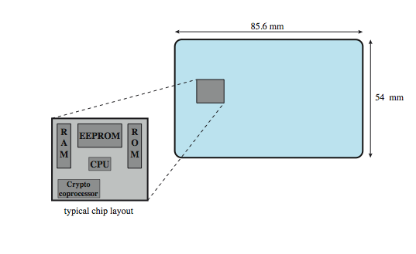
Smartcard
credit-card like
has own processor, memory, I/O ports
  ROM, EEPROM, RAM memory
executes protocol to authenticate with reader/computer
  static: similar to memory cards
  dynamic: passwords created every minute; entered manually by user or electronically
  challenge-response: computer creates a random number; smart card provides its hash (similar to PK)
also have USB dongles
Notes:
45
For user authentication to computer, the most important category of smart token is the smart card, which has the appearance of a credit card, has an electronic interface, and may use any of the possible authentication protocols (static, dynamic password, challenge-response; see text). A smart card contains within it an entire microprocessor, including processor, memory, and I/O ports, as shown in Figure 3.4 from the text. Some versions incorporate a special co-processing circuit for cryptographic operation to speed the task of encoding and decoding messages or generating digital signatures to validate the information transferred. In some cards, the I/O ports are directly accessible by a compatible reader by means of exposed electrical contacts. Other cards rely instead on an embedded antenna for wireless communication with the reader. A typical smart card includes three types of memory. Read-only memory (ROM) stores data that does not change during the card’s life, such as the card number and the cardholder’s name. Electrically erasable programmable ROM (EEPROM) holds application data and programs, such as the protocols that the card can execute. It also holds data that may vary with time. Random access memory (RAM) holds temporary data generated when applications are executed. Figure 3.5 in the text illustrates a typical interaction between a smart card and a reader or computer system. An alternative to the smart card is a small, inexpensive flash memory device known as a USB dongle. It has the same functionality as a smart card, but connects to the existing USB port on a computer, hence it does not need a specific card reader.

Slide 46
Electronic identity cards *
An important application of smart cards
A national e-identity (eID)
Serves the same purpose as other national ID cards (e.g., a driver’s licence)
  Can provide stronger proof of identity
  A German card
    Personal data, Document number, Card access number (six digit random number), Machine readable zone (MRZ): the password
    Uses: ePass (government use), eID (general use), eSign (can have private key and certificate)

Slide 47
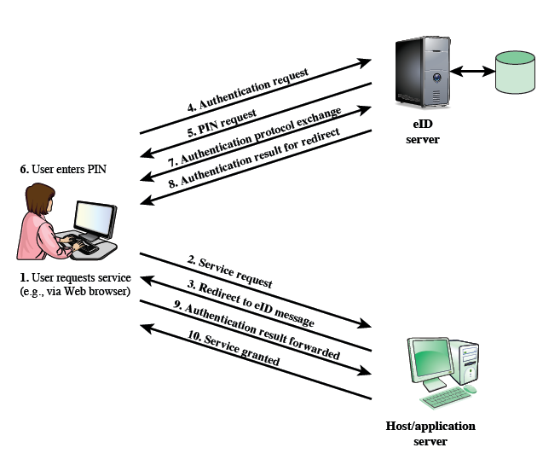
User authentication with eID *

Slide 48
Something You Are
Biometric
  “You are your key” ⎯ Schneier
Examples
  Fingerprint
  Handwritten signature
  Facial recognition
  Speech recognition
  Gait (walking) recognition
  “Digital doggie” (odor recognition)
  Many more!
Are
Know
Have
Part 2 ⎯ Access Control 48

Slide 49
Why Biometrics?
May be better than passwords
But, cheap and reliable biometrics needed
  Today, an active area of research
Biometrics are used in security today
  Thumbprint mouse
  Palm print for secure entry
  Fingerprint to unlock car door, etc.
But biometrics not really that popular
  Has not lived up to its promise/hype (yet?)
Part 2 ⎯ Access Control 49

Slide 50
Biometrics: core idea
Automated measurement of biological, behavioral features that identify a person
  Fingerprints: optical or electrical techniques
    Maps fingerprint into a graph, then compares with database
    Measurements imprecise, so approximate matching algorithms used
  Voices: speaker verification or recognition
    Verification: uses statistical techniques to test hypothesis that speaker is who is claimed (speaker dependent)
    Recognition: checks content of answers (speaker independent)
50
Info-Sec 2023

Slide 51
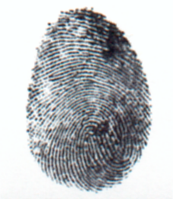
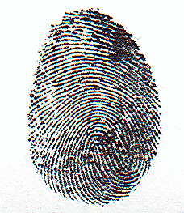
Fingerprint: Enrollment
Capture image of fingerprint
Enhance image
Identify “points”
Part 2 ⎯ Access Control 51

Slide 52
Fingerprint: Recognition
Extracted points are compared with information stored in a database
Is it a statistical match?
Aside: Do identical twins’ fingerprints differ?
Part 2 ⎯ Access Control 52

Slide 53
Other Characteristics
Can use several other characteristics
  Eyes: patterns in irises unique
    Measure patterns, determine if differences are random; or correlate images using statistical tests
  Faces: image, or specific characteristics like distance from nose to chin
    Lighting, view of face, other noise can hinder this
  Keystroke dynamics: believed to be unique
    Keystroke intervals, pressure, duration of stroke, where key is struck
    Statistical tests used
53
Info-Sec 2023

Slide 54
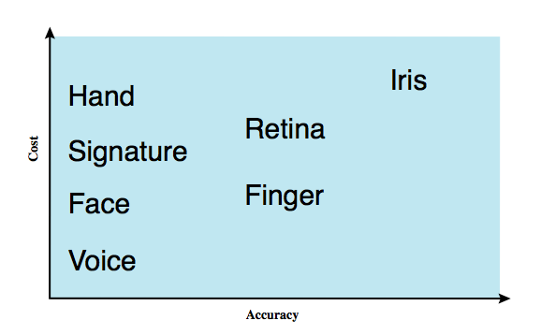
Biometric authentication
Authenticate user based on one of their physical characteristics:
  facial
  fingerprint
  hand geometry
  retina pattern
  iris
  signature
  voice
Notes:
54
A biometric authentication system attempts to authenticate an individual based on unique physical characteristics.These include static characteristics, such as fingerprints, hand geometry, facial characteristics, and retinal and iris patterns; and dynamic characteristics, such as voiceprint and signature. Compared to passwords and tokens, biometric authentication is both technically complex and expensive, and have yet to mature as a standard tool for user authentication to computer systems. A rough indication of the relative cost and accuracy of the most common biometric measures:
• Facial characteristics: define characteristics based on relative location and shape of key facial features, such as eyes, eyebrows, nose, lips, and chin shape.
• Fingerprints: the pattern of ridges and furrows on the surface of the fingertip, believed to be unique across the entire human population. Automated fingerprint systems extract a number of features to use as a surrogate for the full pattern.
• Hand geometry: identify features of hand,: e.g. shape, lengths & widths of fingers.
• Retinal pattern: formed by veins beneath the retinal surface is unique and therefore suitable for identification. Uses a digital image of the retinal pattern by projecting a low-intensity beam of visual or infrared light into the eye.
• Iris: Another unique physical characteristic is the detailed structure of the iris.
• Signature: each individual has a unique style of handwriting, esp in signature.
• Voice: patterns are more closely tied to physical and anatomical characteristics of the speaker, but still have a variation from sample to sample over time from the same speaker,complicating the biometric recognition task.

Slide 55
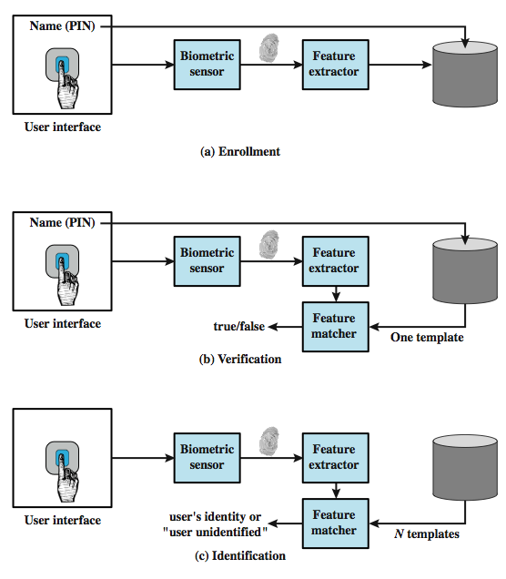
Operation of a biometric system
Verification is analogous to user login via a smart card and a PIN
Identification is biometric info but no IDs; system compares with stored templates
Notes:
55
Each individual who is to be included in the database of authorized users must first be enrolled in the system. This is analogous to assigning a password to a user .For a biometric system, the user presents a name and, typically, some type of password or PIN to the system. At the same time the system senses some biometric characteristic of this user (e.g. fingerprint of right index finger). The system digitizes the input and then extracts a set of features that can be stored as a number or set of numbers representing this unique biometric characteristic ;this set of numbers is referred to as the user’s template. The user is now enrolled in the system, which maintains for the user a name (ID), perhaps a PIN or password, and the biometric value. Depending on application, user authentication on a biometric system involves either verification or identification. Verification is analogous to a user logging on to a system by using a memory card or smart card coupled with a password or PIN. For biometric verification, the user enters a PIN and also uses a biometric sensor. The system extracts the corresponding feature and compares that to the template stored for this user. If there is a match, then the system authenticates this user. For an identification system, the individual uses the biometric sensor but presents no additional information. The system then compares the presented template with the set of stored templates. If there is a match, then this user is identified. Otherwise, the user is rejected.

Slide 56
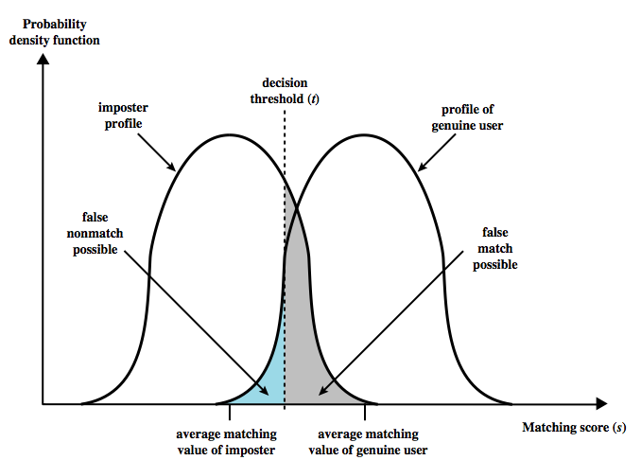
Biometric Accuracy *
* Further reading (Stallings textbook)
Palm print The system generates a matching score (a number) that quantifies similarity between the input and the stored template
Concerns: sensor noise and detection inaccuracy
Problems of false match/false non-match
Notes:
56
In any biometric scheme, some physical characteristic of the individual is mapped into a digital representation. For each individual, a single digital representation, or template, is stored in the computer. When the user is to be authenticated, the system compares the stored template to the presented template. Given the complexities of physical characteristics, we cannot expect that there will be an exact match between the two templates. Rather, the system uses an algorithm to generate a matching score (typically a single number) that quantifies the similarity between the input and the stored template. Figure 3.8 illustrates the dilemma posed to the system. If a single user is tested by the system numerous times, the matching score swill vary, with a probability density function typically forming a bell curve, as shown. On average, any other individual should have a much lower matching score but again will exhibit a bell-shaped probability density function .The difficulty is that the range of matching scores produced by two individuals, one genuine and one an imposter, compared to a given reference template, are likely to overlap. In Figure 3.8 a threshold value is selected so that if the presented value is s>=t then a match is assumed, and for s< t, a mismatch is assumed. The shaded part to the right of t indicates a range of values for which a false match is possible, and the shaded part to the left indicates a range of values for which a false nonmatch is possible. The area of each shaded part represents to probability of a false match or nonmatch, respectively. By moving the threshold, left or right, the probabilities can be altered, but note that an decrease in false match rate necessarily results in an increase in false nonmatch rate, and vice versa.

Slide 57
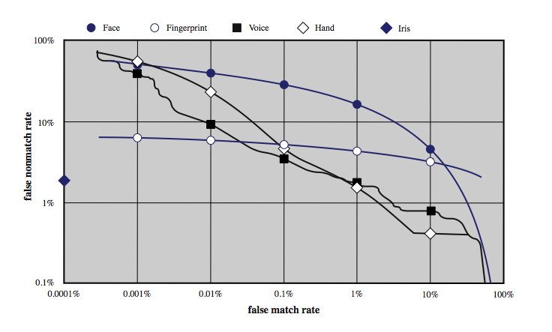
Biometric Accuracy *
Can plot characteristic curve (2,000,000 comparisons)
Pick threshold balancing error rates
Notes:
57
For a given biometric scheme, we can plot the false match versus false non-match rate, called the operating characteristic curve. Figure 3.9 in the text shows representative curves for two different systems. A reasonable tradeoff is to pick a threshold t that corresponds to a point on the curve where the rates are equal. A high-security application may require a very low false match rate, resulting in a point farther to the left on the curve. For a forensic application, in which the system is looking for possible candidates, to be checked further, the requirement may be for a low false non-match rate. Figure 3.10 on this slide from the text, shows characteristic curves developed from actual product testing. The iris system had no false matches in over 2 million cross-comparisons. Note that over a broad range of false match rates, the face biometric is the worst performer.

Slide 58
Cautions
These can be fooled!
  Assumes biometric device accurate in the environment it is being used in!
  Transmission of data to validator is tamperproof, correct
58
Info-Sec 2023

Slide 59
Biometrics: The Bottom Line
Biometrics are hard to forge
But attacker could
  Steal Alice’s thumb
  Photocopy Bob’s fingerprint, eye, etc.
  Subvert software, database, “trusted path” …
And how to revoke a “broken” biometric?
Biometrics are not foolproof
Biometric use is relatively limited today
That should change in the (near?) future
Part 2 ⎯ Access Control 59

Slide 60
Location – Just a brief
If you know where user is, validate identity by seeing if person is where the user is
  Requires special-purpose hardware to locate user
    GPS (global positioning system) device gives location signature of entity
    Host uses LSS (location signature sensor) to get signature for entity
60
Info-Sec 2023

Slide 61
Multiple Methods
Example: “where you are” also requires entity to have LSS and GPS, so also “what you have”
Can assign different methods to different tasks
  As users perform more and more sensitive tasks, must authenticate in more and more ways (presumably, more stringently) File describes authentication required
    Also includes controls on access (time of day, etc.), resources, and requests to change passwords
  Pluggable Authentication Modules
61
Info-Sec 2023

Slide 62
PAM
Idea: when program needs to authenticate, it checks central repository for methods to use
Library call: pam_authenticate
  Accesses file with name of program in /etc/pam_d
Modules do authentication checking
  sufficient: succeed if module succeeds
  required: fail if module fails, but all required modules executed before reporting failure
  requisite: like required, but don’t check all modules
  optional: invoke only if all previous modules fail
62
Info-Sec 2023

Slide 63
Example PAM File
auth sufficient /usr/lib/pam_ftp.so
auth required /usr/lib/pam_unix_auth.so use_first_pass
auth required /usr/lib/pam_listfile.so onerr=succeed \ item=user sense=deny file=/etc/ftpusers
For ftp:
If user “anonymous”, return okay; if not, set PAM_AUTHTOK to password, PAM_RUSER to name, and fail
Now check that password in PAM_AUTHTOK belongs to that of user in PAM_RUSER; if not, fail
Now see if user in PAM_RUSER named in /etc/ftpusers; if so, fail; if error or not found, succeed
63
Info-Sec 2023

Slide 64
Extended Material *
Kerberos authentication protocol
Material sources: History & some general info from Wiki;
Details on Kerberos versions 4&5 from Stallings Text and slides

Slide 65
Kerberos
A computer network authentication protocol
  which allows nodes communicating over a non-secure network to prove their identity to one another in a secure manner.
  aimed primarily at a client-server model, and it provides mutual authentication -- both the user and the server verify each other's identity. Messages are protected against eaves dropping & replay attacks.
  Kerberos builds on SKC and requires a trusted third party, and optionally may use public-key cryptography during certain phases of authentication.
65
Info-Sec 2023

Slide 66
Kerberos
History [Wiki]
  named after the character Kerberos (or Cerberus), the ferocious three-headed guard dog of Hades (from Greek mythology)
  MIT developed Kerberos in 1988 to protect network services provided by Project Athena.
  1st version was primarily designed by Steve Miller and Clifford Neuman based on the earlier Needham–Schroeder symmetric-key protocol. Ver 1 - 3 were experimental, internal.
  Kerberos version 4, the first public version, was released on January 24, 1989.
  Neuman and John Kohl published v5 in 1993 with the intention of overcoming existing limitations and security problems. Version 5 appeared as RFC 1510, which was then made obsolete by RFC 4120 in 2005. In 2005, the Internet Engineering Task Force (IETF) Kerberos working group updated specifications.
Information Security by Van K Nguyen Hanoi University of Technology
66
Sep 2009

Slide 67
Idea
Ticket
  Issuer vouches for identity of requester of service
  Identifies sender
Key Distribution Center (KDC) combines two severs:
  Authentication Server, AS (Also, Kerberos server)
  Ticket Granting Server, TGS
User u authenticates to AS
    Obtains ticket T_{u,TGS} for ticket granting service (TGS)
User u wants to use service s:
  User sends authenticator A_{u}, ticket T_{u,TGS} to TGS asking for ticket for service
  TGS sends ticket T_{u,s} to user
  User sends A_{u}, T_{u,s} to server as request to use s
Information Security by Van K Nguyen Hanoi University of Technology
67
Sep 2009

Slide 68
Kerberos v4 Overview
a basic third-party authentication scheme
have an Authentication Server (AS)
  users initially negotiate with AS to identify self
  AS provides a non-corruptible authentication credential (ticket granting ticket TGT)
have a Ticket Granting server (TGS)
  users subsequently request access to other services from TGS on basis of users TGT
using a complex protocol using DES
Notes:
68
The core of Kerberos is the Authentication and Ticket Granting Servers – these are trusted by all users and servers and must be securely administered. The protocol includes a sequence of interactions between the client, AS, TGT and desired server. Version 4 of Kerberos makes use of DES, in a rather elaborate protocol, to provide the authentication service. Viewing the protocol as a whole, it can be difficult to see the need for the many elements contained therein. The text contains more detailed discussion about the development of and need for the components of the final v4 protocol.

Slide 69
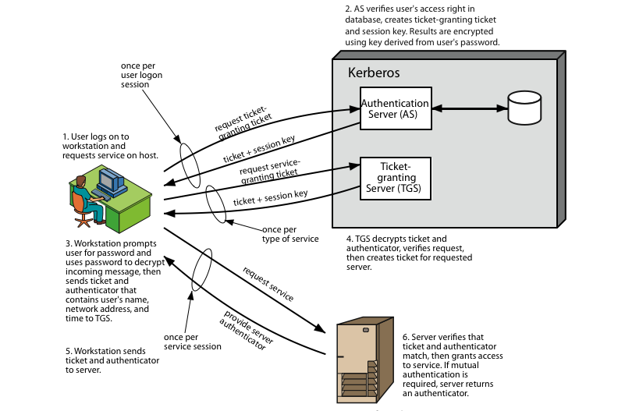
Kerberos 4 Overview
Notes:
69
Stallings Figure 15.1 diagrammatically summarizes the Kerberos v4 authentication dialogue, with 3 pairs of messages, for each phase listed previously.

Slide 70
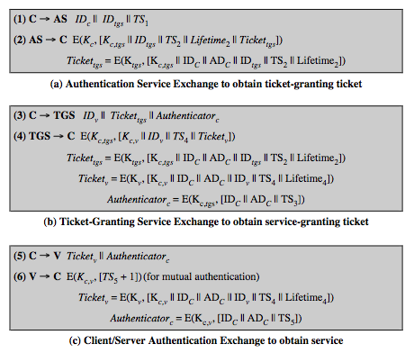
Kerberos v4 Dialogue
Notes:
70
The full Kerberos v4 authentication dialogue is shown here from Stallings Table 15.1, divided into 3 phases. The justification for each item in the messages is given in Stallings Table 15.2.
First, consider the problem of captured ticket-granting tickets and the need to determine that the ticket presenter is the same as the client for whom the ticket was issued. An efficient way of doing this is to use a session encryption key to secure information. Table 15.1a shows the technique for distributing the session key. Note that several additional pieces of information have been added to this first phase of the dialogue. Message (1) includes a timestamp, so that the AS knows that the message is timely. Message (2) includes several elements of the ticket in a form accessible to C. This enables C to confirm that this ticket is for the TGS and to learn its expiration time. Note that the ticket does not prove anyone's identity but is a way to distribute keys securely. It is the authenticator that proves the client's identity. Because the authenticator can be used only once and has a short lifetime, the threat of an opponent stealing both the ticket and the authenticator for presentation later is countered. C then sends the TGS a message that includes the ticket plus the ID of the requested service (message 3). The reply from the TGS, in message (4), follows the form of message (2). C now has a reusable service-granting ticket for V. When C presents this ticket, as shown in message (5), it also sends an authenticator. The server can decrypt the ticket, recover the session key, and decrypt the authenticator. If mutual authentication is required, the server can reply as shown in message (6)

Slide 71
Kerberos Version 5
developed in mid 1990’s
specified as Internet standard RFC 1510
provides improvements over v4
  addresses environmental shortcomings
    encryption alg, network protocol, byte order, ticket lifetime, authentication forwarding, interrealm auth
  and technical deficiencies
    double encryption, non-std mode of use, session keys, password attacks
Notes:
71
Kerberos Version 5 is specified in RFC 1510 and provides a number of improvements over version 4 in the areas of environmental shortcomings and technical deficiencies, in areas as noted. See Stallings Table 14.3 for details of the Kerberos v5 authentication dialogue.

Slide 72
Kerberos Realms
a Kerberos environment consists of:
  a Kerberos server
  a number of clients, all registered with server
  application servers, sharing keys with server
this is termed a realm
  typically a single administrative domain
if have multiple realms, their Kerberos servers must share keys and trust
Notes:
72
A full-service Kerberos environment consisting of a Kerberos server, a number of clients, and a number of application servers is referred to as a Kerberos realm. A Kerberos realm is a set of managed nodes that share the same Kerberos database, and are part of the same administrative domain. If have multiple realms, their Kerberos servers must share keys and trust each other.

Slide 73
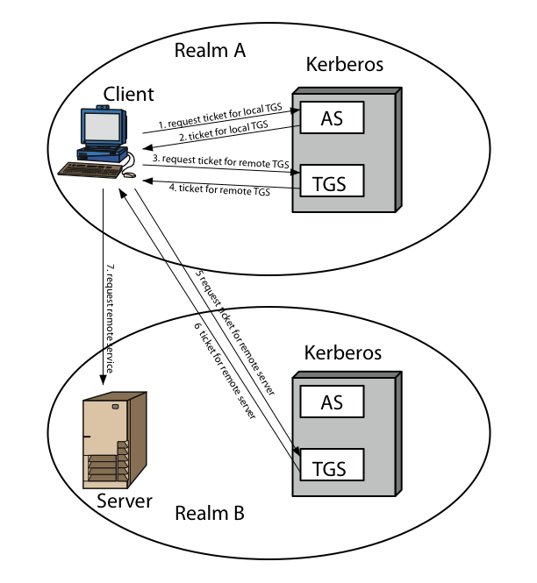
Kerberos Realms
Notes:
73
Stallings Figure 15.2 shows the authentication messages where service is being requested from another domain. The ticket presented to the remote server indicates the realm in which the user was originally authenticated. The server chooses whether to honor the remote request. One problem presented by the foregoing approach is that it does not scale well to many realms, as each pair of realms need to share a key.

Slide 74
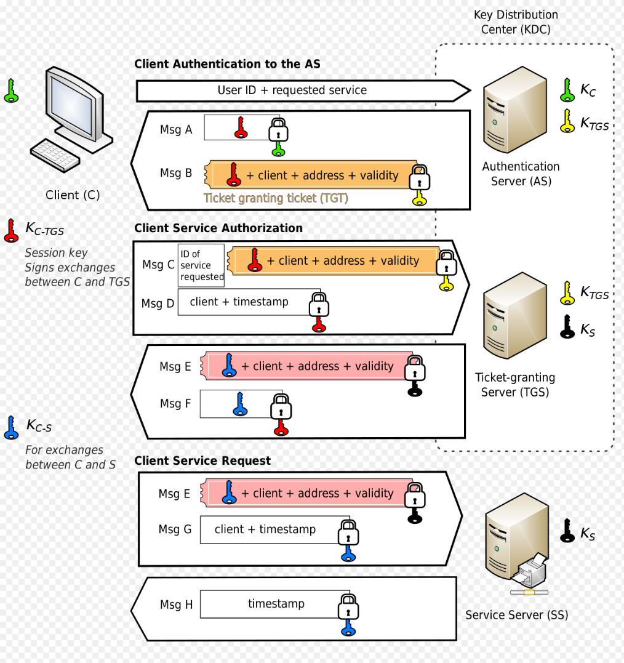
Protocol
[From Wiki]
Client Authentication to the AS
Client Service Authorization
Client Service Request

Slide 75
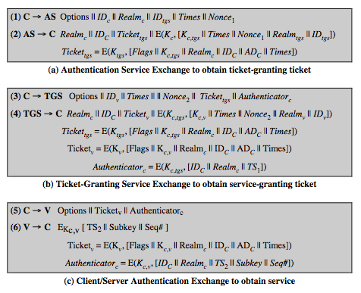
Kerberos v5 Dialogue
Notes:
75
The basic Kerberos version 5 authentication dialogue is shown here from Stallings Table 15.3. First, consider the authentication service exchange.
Message (1) is a client request for a ticket-granting ticket.
Message (2) returns a ticket-granting ticket, identifying information for the client, and a block encrypted using the encryption key based on the user's password. This block includes the session key to be used between the client and the TGS.
Now compare the ticket-granting service exchange for versions 4 and 5. See that message (3) for both versions includes an authenticator, a ticket, and the name of the requested service. In addition, version 5 includes requested times and options for the ticket and a nonce, all with functions similar to those of message (1). The authenticator itself is essentially the same as the one used in version 4. Message (4) has the same structure as message (2), returning a ticket plus information needed by the client, the latter encrypted with the session key now shared by the client and the TGS. Finally, for the client/server authentication exchange, several new features appear in version 5, such as a request for mutual authentication. If required, the server responds with message (6) that includes the timestamp from the authenticator. The flags field included in tickets in version 5 supports expanded functionality compared to that available in version 4. Stallings Table 15.4 summarizes the flags that may be included in a ticket., with discussion of details in the text.

Slide 76
Federated Identity Management
use of common identity management scheme
  across multiple enterprises & numerous applications
  supporting many thousands, even millions of users
principal elements are:
  authentication, authorization, accounting, provisioning, workflow automation, delegated administration, password synchronization, self-service password reset, federation
Kerberos contains many of these elements
Notes:
76
Federated identity management is a relatively new concept dealing with the use of a common identity management scheme across multiple enterprises and numerous applications and supporting many thousands, even millions of users. Identity management is a centralized, automated approach to provide enterprise-wide access to resources by employees and other authorized individuals, defining an identity for each user (human or process), associating attributes with the identity, and enforcing a means by which a user can verify identity. Its principal elements are:
• Authentication: confirmating user corresponds to the user name provided.
• Authorization: granting access to services/resources given user authentication.
• Accounting: process for logging access and authorization.
• Provisioning: enrollment of users in the system.
• Workflow automation: movement of data in a business process.
• Delegated administration: use of role-based access control to grant permissions.
• Password synchronization: Creating a process for single sign-on (SSO) or reduced sign-on (RSO).
• Self-service password reset: enable user to modify their password
• Federation: process where authentication and permission will be passed on from one system to another, usually across multiple enterprises, reducing the number of authentications needed by the user.
Kerberos contains a number of the elements of an identity management system.

Slide 77
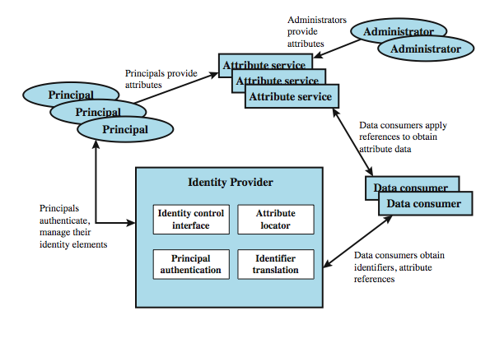
Identity Management
Notes:
77
Figure 15.3 illustrates entities and data flows in a generic identity management architecture. A principal is an identity holder. Typically, this is a human user that seeks access to resources and services on the network. User devices, agent processes, and server systems may also function as principals. Principals authenticate themselves to an identity provider. The identity provider associates authentication information with a principal, as well as attributes and one or more identifiers.
Increasingly, digital identities incorporate attributes other than simply an identifier and authentication information (such as passwords and biometric information). An attribute service manages the creation and maintenance of such attributes. For example, a user needs to provide a shipping address each time an order is placed at a new Web merchant, and this information needs to be revised when the user moves. Identity management enables the user to provide this information once, so that it is maintained in a single place and released to data consumers in accordance with authorization and privacy policies. Users may create some of the attributes to be associated with their digital identity, such as address. Administrators may also assign attributes to users, such as roles, access permissions, and employee information.
Data consumers are entities that obtain and employ data maintained and provided by identity and attribute providers, often to support authorization decisions and to collect audit information. For example, a database server or file server is a data consumer that needs a client's credentials so as to know what access to provide to that client.

Slide 78
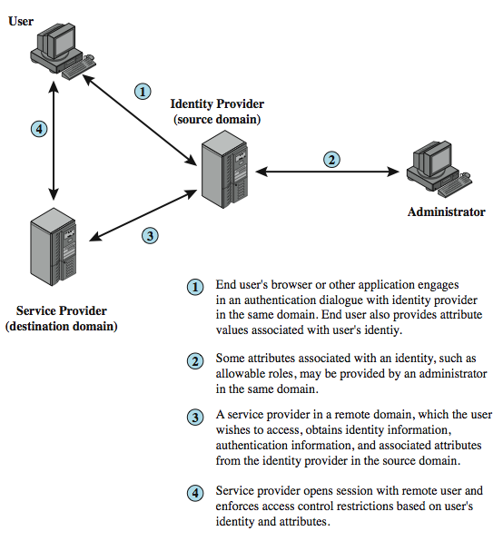
Identity Federation
Notes:
Identity federation is, in essence, an extension of identity management to multiple security domains. Federated identity management refers to the agreements, standards, and technologies that enable the portability of identities, identity attributes, and entitlements across multiple enterprises and numerous applications and supporting many thousands, even millions, of users. Stallings Figure 15.4 illustrates entities and data flows in a generic federated identity management architecture. The identity provider acquires attribute information through dialogue and protocol exchanges with users and administrators. Identity management enables the user to provide this information once, so that it is maintained in a single place and released to data consumers in accordance with authorization and privacy policies. Service providers are entities that obtain and employ data maintained and provided by identity providers, often to support authorization decisions and to collect audit information. A service provider can be in the same domain as the user and the identity provider. The power of this approach is for federated identity management, in which the service provider is in a different domain.
78

Slide 79
Standards Used
Security Assertion Markup Language (SAML)
  XML-based language for exchange of security information between online business partners
part of OASIS (Organization for the Advancement of Structured Information Standards) standards for federated identity management
  e.g. WS-Federation for browser-based federation
need a few mature industry standards
Notes:
79
Federated identity management uses a number of standards as the building blocks for secure identity exchange across different domains or heterogeneous systems. In essence, organizations issue some form of security tickets for their users that can be processed by cooperating partners. Identity federation standards are thus concerned with defining these tickets, in terms of content and format, providing protocols for exchanging tickets and performing a number of management tasks. These tasks include configuring systems to perform attribute transfers and identity mapping, and performing logging and auditing functions. The principal underlying standard for federated identity is the Security Assertion Markup Language (SAML), which SAML is an XML-based language that defines the exchange of security information between online business partners. SAML conveys authentication information in the form of assertions about subjects. Assertions are statements about the subject issued by an authoritative entity.
SAML is part of a broader collection of standards being issued by OASIS (Organization for the Advancement of Structured Information Standards) for federated identity management. For example, WS-Federation enables browser-based federation; it relies on a security token service to broker trust of identities, attributes, and authentication between participating Web services. The challenge with federated identity management is to integrate multiple technologies, standards, and services to provide a secure, user-friendly utility. The key, as in most areas of security and networking, is the reliance on a few mature standards widely accepted by industry. Federated identity management seems to have reached this level of maturity.

Slide 80
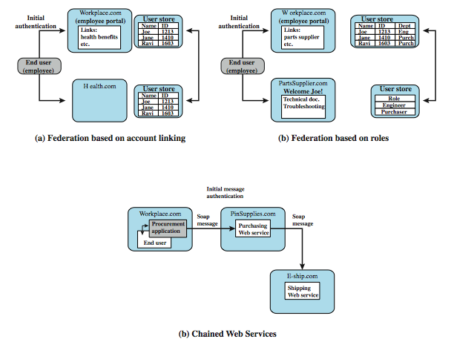
Federated Identity Examples
Notes:
80
To get some feel for the functionality of identity federation, we look at three scenarios, taken from [COMP06] (more details in text).
In the first (Figure 15.5a), Workplace.com contracts with Health.com to provide employee health benefits. An employee signs on and authenticates to Workplace.com. The two organizations federated and cooperatively exchanges user identifiers. Health.com maintains user identities for every employee at Workplace.com and associates with each identity health benefits info & access rights.
Figure 15.5b shows another browser-based scheme. PartsSupplier.com is a regular supplier of parts to Workplace.com. A role-based access control (RBAC) scheme is used. An engineer of Workplace.com authenticates to Workplace.com and clicks on a link to access information at PartsSupplier.com. For this scenario, PartSupplier.com does not have identity information for individual employees at Workplace.com. Rather, the linkage between the two federated partners is in terms of roles.
The scenario in Figure 15.5c can be referred to as document-based. Workplace.com has a purchasing agreement with PinSupplies.com which has a business relationship with E-Ship.com. An employee of WorkPlace.com signs on and is authenticated to make purchases. The procurement application generates an XML/SOAP order document, and inserts into the header the user's credentials and Workplace.com's organizational identity. It then posts the message to the PinSupplies.com's purchasing Web service. This service authenticates the incoming message and processes the request, sending a SOAP message to its shipping partner to fulfill the order.

Slide 81
FIM vs. SSO
SSO: Single Sign-On
  Allows users to access multiple web applications at once, using just one set of credentials.
    Beyond the workforce, companies can utilize SSO to help customers access various sections of one account.
FIM
  As a tool, SSO fits within the broader model of FIM.
  The key difference between SSO and FIM is while SSO is designed to authenticate a single credential across various systems within one organization, federated identity management systems offer single access to a number of applications across various enterprises.
Notes:
For businesses that deploy various applications for HR, payroll, and communications, an SSO solution allows employees to access each of those services with just one login. This makes it easier for users to do their job—as they no longer have to remember multiple passwords—and also reduces the amount of time IT spends on password resets.
Beyond the workforce, companies can utilize SSO to help customers access various sections of one account. For instance, retail networks with many brands can use SSO to let customers access their accounts with each store from one central dashboard, enhancing their user experience. When shifting between each one, the site re-authenticates users with the same credentials.
This model was developed to address the constraints posed by early internet infrastructure, where entities on one domain could not access user information stored in other domains. For companies that operated across various domains, this was particularly problematic, as it made it difficult to create streamlined experiences for employees and customers alike.
Added to that, in a FIM system, the onus of reviewing and authenticating user credentials is with an identity provider (IdP), not the applications themselves. So, when a user attempts to log into a specific service provider (SP) or application, the SP then communicates with the IdP to authenticate the user. This user identity authorization is often executed through open-sourced Security Assertion Markup Language (SAML), or other related standards like OAuth or OpenID Connect.
So, while SSO is a function of FIM, having SSO in place won’t necessarily allow for federated identity management. That said, both tools are crucial in supporting organizations with both securing their data and minimizing obstacles in user experience.
81

Slide 82
Extended Material *
Biometrics
Slides borrowed from Mark Stamp’s web
https://www.cs.sjsu.edu/~stamp/infosec/powerpoint/

Slide 83
Something You Are
Biometric
  “You are your key” ⎯ Schneier
Examples
  Fingerprint
  Handwritten signature
  Facial recognition
  Speech recognition
  Gait (walking) recognition
  “Digital doggie” (odor recognition)
  Many more!
Are
Know
Have
Part 2 ⎯ Access Control 83

Slide 84
Ideal Biometric
Universal ⎯ applies to (almost) everyone
  In reality, no biometric applies to everyone
Distinguishing ⎯ distinguish with certainty
  In reality, cannot hope for 100% certainty
Permanent ⎯ physical characteristic being measured never changes
  In reality, OK if it to remains valid for long time
Collectable ⎯ easy to collect required data
  Depends on whether subjects are cooperative
Also, safe, user-friendly, and ???
Part 2 ⎯ Access Control 84

Slide 85
Identification vs Authentication
Identification ⎯ Who goes there?
  Compare one-to-many
  Example: FBI fingerprint database
Authentication ⎯ Are you who you say you are?
  Compare one-to-one
  Example: Thumbprint mouse
Identification problem is more difficult
  More “random” matches since more comparisons
We are (mostly) interested in authentication
Part 2 ⎯ Access Control 85

Slide 86
Enrollment vs Recognition
Enrollment phase
  Subject’s biometric info put into database
  Must carefully measure the required info
  OK if slow and repeated measurement needed
  Must be very precise
  May be a weak point in real-world use
Recognition phase
  Biometric detection, when used in practice
  Must be quick and simple
  But must be reasonably accurate
Part 2 ⎯ Access Control 86

Slide 87
Cooperative Subjects?
Authentication ⎯ cooperative subjects
Identification ⎯ uncooperative subjects
For example, facial recognition
  Used in Las Vegas casinos to detect known cheaters (also, terrorists in airports, etc.)
  Often, less than ideal enrollment conditions
  Subject will try to confuse recognition phase
Cooperative subject makes it much easier
  We are focused on authentication
  So, we can assume subjects are cooperative
Part 2 ⎯ Access Control 87

Slide 88
Biometric Errors
Fraud rate versus insult rate
  Fraud ⎯ Trudy mis-authenticated as Alice
  Insult ⎯ Alice not authenticated as Alice
For any biometric, can decrease fraud or insult, but other one will increase
For example
  99% voiceprint match ⇒ low fraud, high insult
  30% voiceprint match ⇒ high fraud, low insult
Equal error rate: rate where fraud == insult
  A way to compare different biometrics
Part 2 ⎯ Access Control 88

Slide 89
Fingerprint History
1823 ⎯ Professor Johannes Evangelist Purkinje discussed 9 fingerprint patterns
1856 ⎯ Sir William Hershel used fingerprint (in India) on contracts
1880 ⎯ Dr. Henry Faulds article in Nature about fingerprints for ID
1883 ⎯ Mark Twain’s Life on the Mississippi (murderer ID’ed by fingerprint)
Part 2 ⎯ Access Control 89

Slide 90
Fingerprint History
1888 ⎯ Sir Francis Galton developed classification system
  His system of “minutia” can be used today
  Also verified that fingerprints do not change
Some countries require fixed number of “points” (minutia) to match in criminal cases
  In Britain, at least 15 points
  In US, no fixed number of points
Part 2 ⎯ Access Control 90

Slide 91
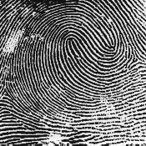
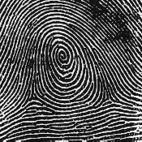
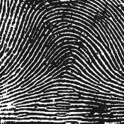
Fingerprint Comparison
Examples of loops, whorls, and arches
Minutia extracted from these features
Loop (double)
Whorl
Arch
Part 2 ⎯ Access Control 91

Slide 92
Fingerprint: Enrollment
Capture image of fingerprint
Enhance image
Identify “points”
Part 2 ⎯ Access Control 92

Slide 93
Fingerprint: Recognition
Extracted points are compared with information stored in a database
Is it a statistical match?
Aside: Do identical twins’ fingerprints differ?
Part 2 ⎯ Access Control 93

Slide 94
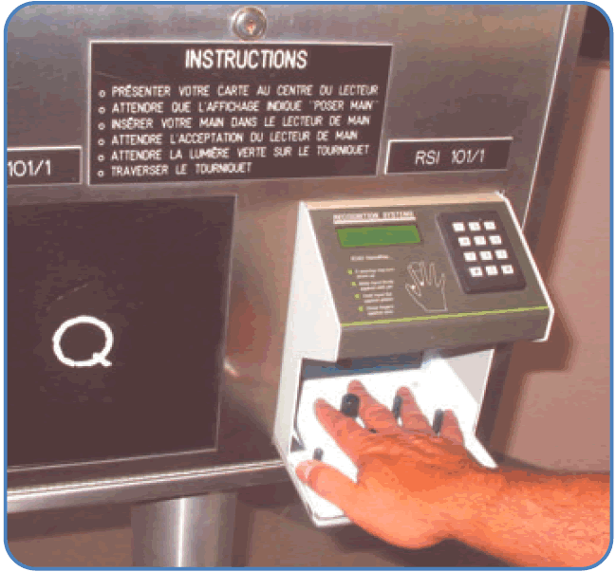
Hand Geometry
A popular biometric
Measures shape of hand
  Width of hand, fingers
  Length of fingers, etc.
Human hands not so unique
Hand geometry sufficient for many situations
OK for authentication
Not useful for ID problem
Part 2 ⎯ Access Control 94

Slide 95
Hand Geometry
Advantages
  Quick ⎯ 1 minute for enrollment, 5 seconds for recognition
  Hands are symmetric ⎯ so what?
Disadvantages
  Cannot use on very young or very old
  Relatively high equal error rate
Part 2 ⎯ Access Control 95

Slide 96
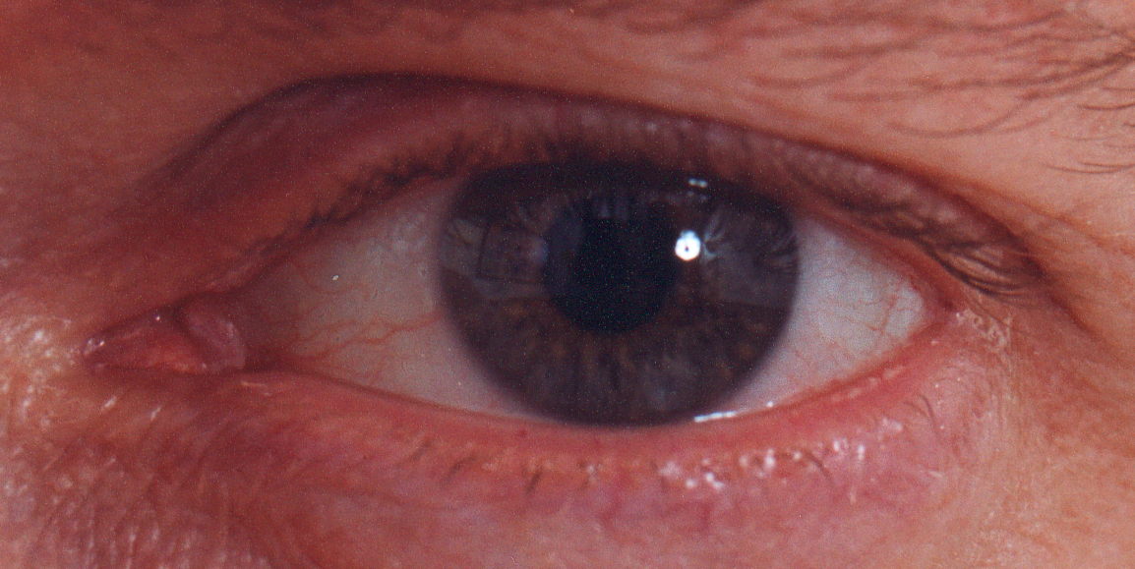
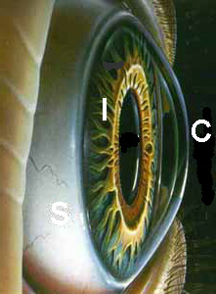

Iris Patterns
Iris pattern development is “chaotic”
Little or no genetic influence
Even for identical twins, uncorrelated
Pattern is stable through lifetime
Part 2 ⎯ Access Control 96

Slide 97
Iris Recognition: History
1936 ⎯ suggested by ophthalmologist
1980s ⎯ James Bond film(s)
1986 ⎯ first patent appeared
1994 ⎯ John Daugman patents new-and-improved technique
  Patents owned by Iridian Technologies
Part 2 ⎯ Access Control 97
Notes:
The Bond film “Never Say Never Again” prominently features an iris recognition system.
97

Slide 98

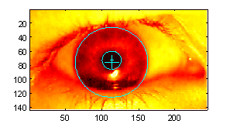
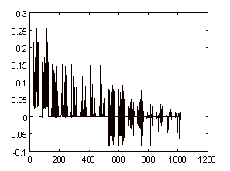
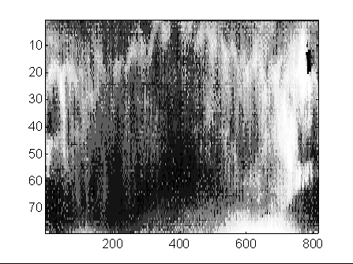
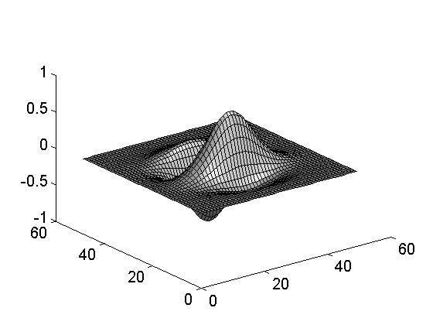
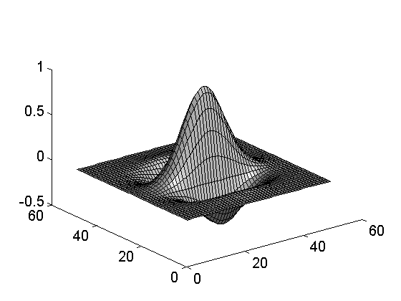
Iris Scan
Scanner locates iris
Take b/w photo
Use polar coordinates…
2-D wavelet transform
Get 256 byte iris code
Part 2 ⎯ Access Control 98

Slide 99
Measuring Iris Similarity
Based on Hamming distance
Define d(x,y) to be
  # of non-match bits / # of bits compared
  d(0010,0101) = 3/4 and d(101111,101001) = 1/3
Compute d(x,y) on 2048-bit iris code
  Perfect match is d(x,y) = 0
  For same iris, expected distance is 0.08
  At random, expect distance of 0.50
  Accept iris scan as match if distance < 0.32
Part 2 ⎯ Access Control 99

Slide 100
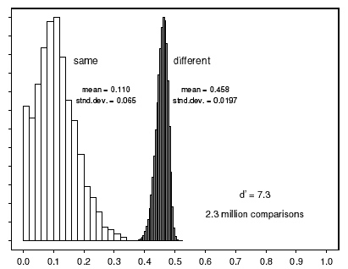

Iris Scan Error Rate
distance
Fraud rate
0.29 | 1 in 1.3*10¹⁰
0.30 | 1 in 1.5*10⁹
0.31 | 1 in 1.8*10⁸
0.32 | 1 in 2.6*10⁷
0.33 | 1 in 4.0*10⁶
0.34 | 1 in 6.9*10⁵
0.35 | 1 in 1.3*10⁵
== equal error rate
distance
Part 2 ⎯ Access Control 100

Slide 101
Attack on Iris Scan
Good photo of eye can be scanned
  Attacker could use photo of eye
Afghan woman was authenticated by iris scan of old photo
  Story can be found here
To prevent attack, scanner could use light to be sure it is a “live” iris
Part 2 ⎯ Access Control 101

Slide 102
Equal Error Rate Comparison
Equal error rate (EER): fraud == insult rate
Fingerprint biometrics used in practice have EER ranging from about 10⁻³ to as high as 5%
Hand geometry has EER of about 10⁻³
In theory, iris scan has EER of about 10⁻⁶
  Enrollment phase may be critical to accuracy
Most biometrics much worse than fingerprint!
Biometrics useful for authentication…
  …but for identification, not so impressive today
Part 2 ⎯ Access Control 102
Notes:
While fingerprints can be highly distinguishing, fingerprint biometrics vary a lot in quality some are really poor
102

Slide 103
Biometrics: The Bottom Line
Biometrics are hard to forge
But attacker could
  Steal Alice’s thumb
  Photocopy Bob’s fingerprint, eye, etc.
  Subvert software, database, “trusted path” …
And how to revoke a “broken” biometric?
Biometrics are not foolproof
Biometric use is relatively limited today
That should change in the (near?) future
Part 2 ⎯ Access Control 103

Slide 104

http://pc.vietica.com/van.nguyen/InfoSec-VietNhat/InfoSec.htm

